Slide 1
Vegetation Zones

Slide 2
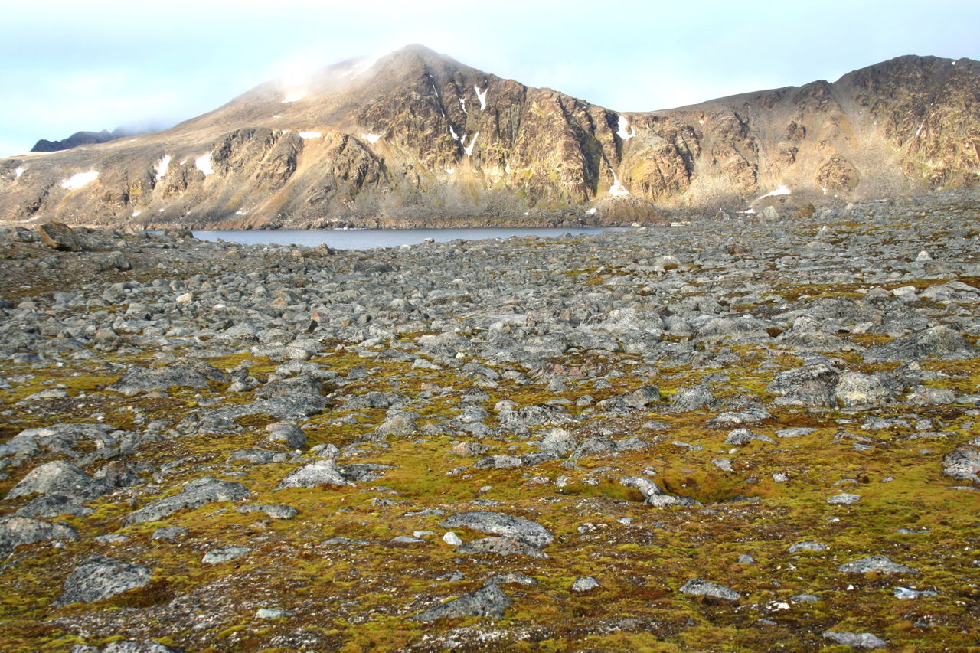
tundra
treeless plain with grasses, mosses and scrubs adapted to a cool climate

Slide 3
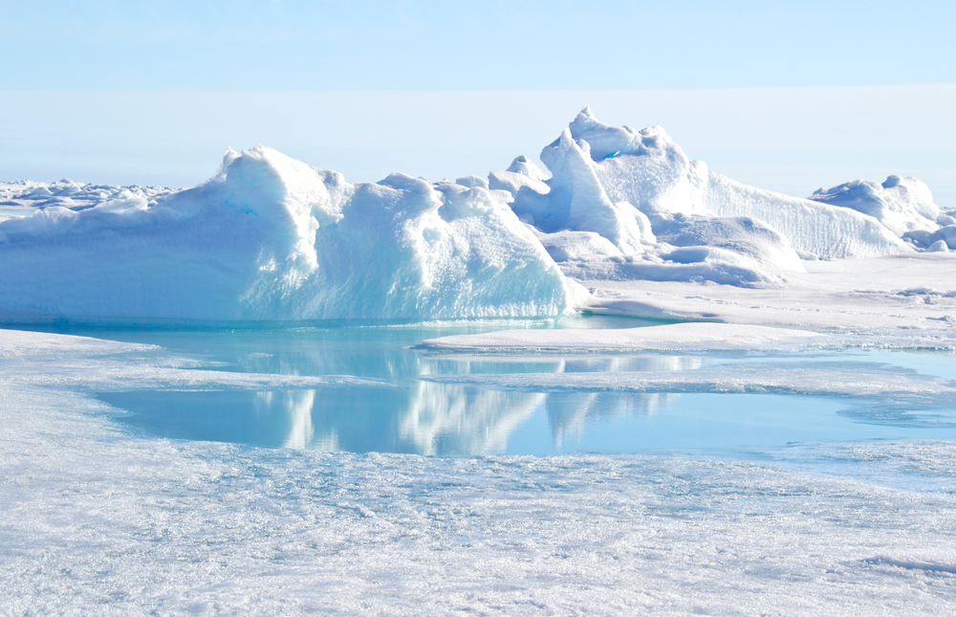
Ice cap
permanent ice and snow with no plant life

Slide 4
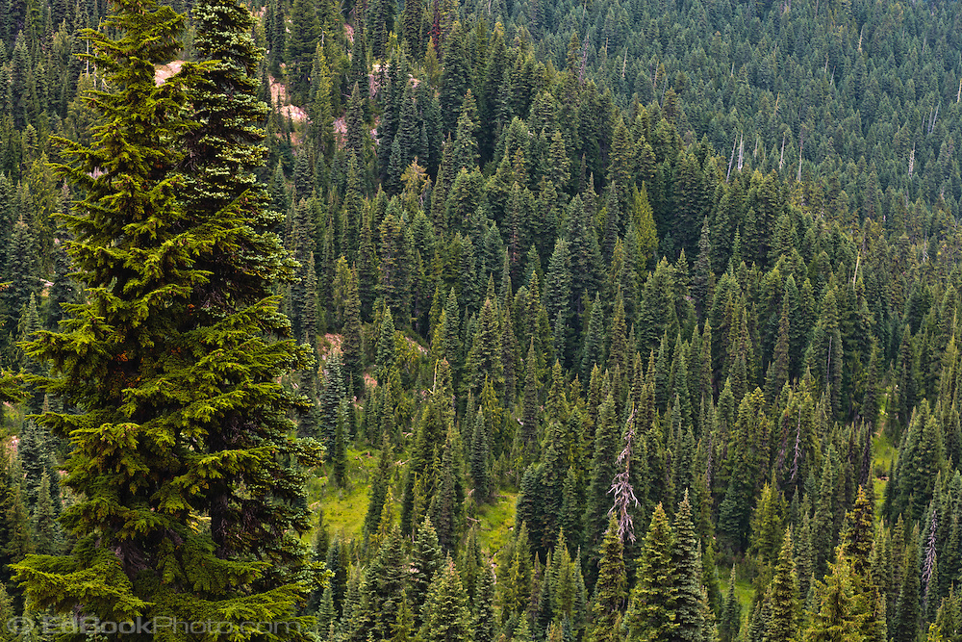
coniferous forest
evergreen trees with needles and cones

Slide 5
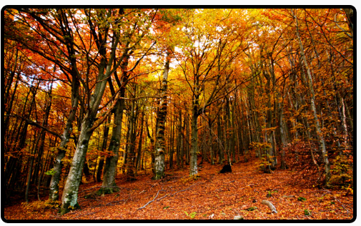
deciduous forest
trees with broad, flat leaves that are shed before winter

Slide 6
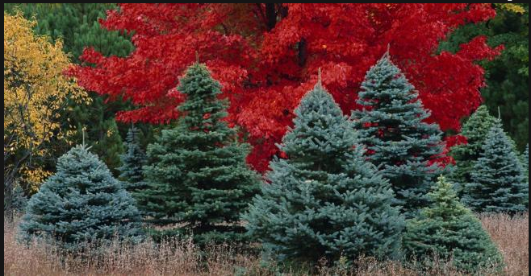
mixed forest
a mix of coniferous and deciduous trees

Slide 7
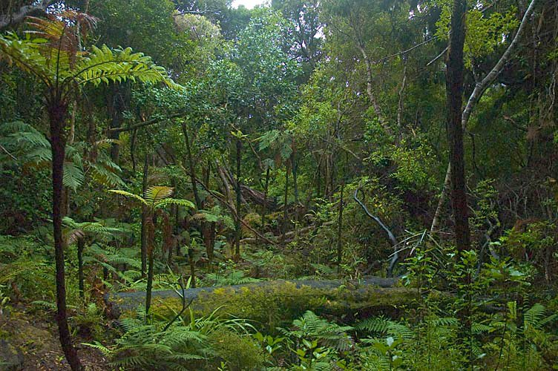
broadleaf evergreen forest
tall trees with large leaves that remain green all year

Slide 8
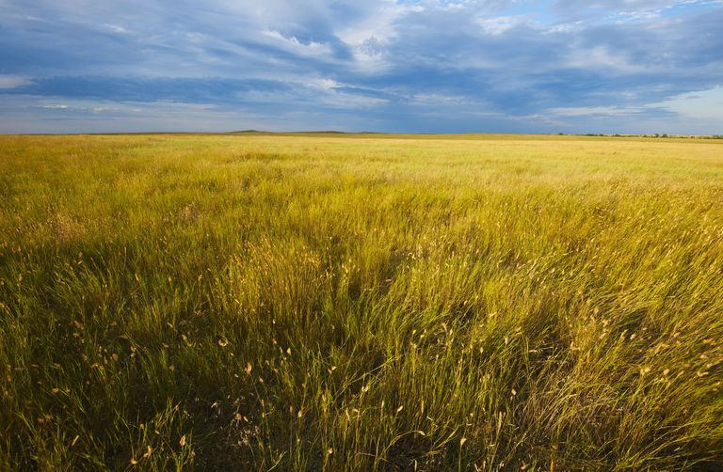
temperate grassland
short and tall grasses adapted to cool climates

Slide 9
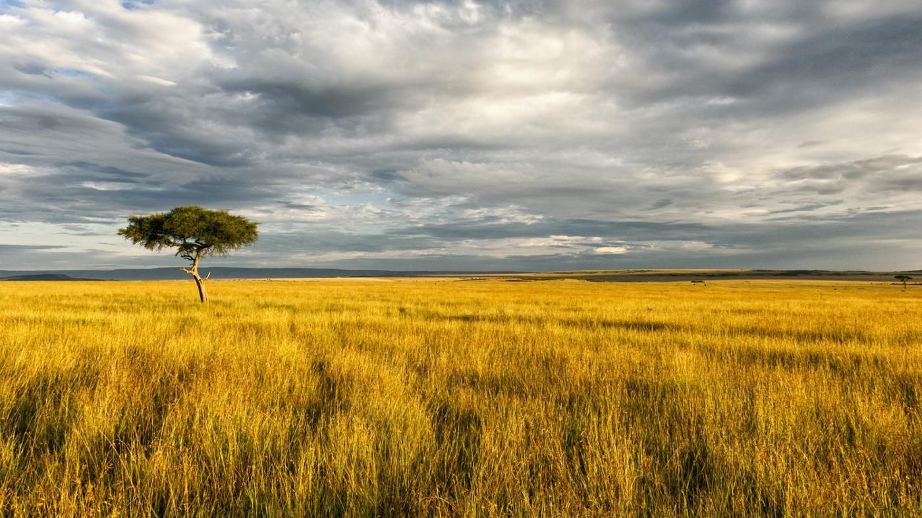
tropical grassland
grasses and scattered trees adapted to a tropical wet dry climate

Slide 10
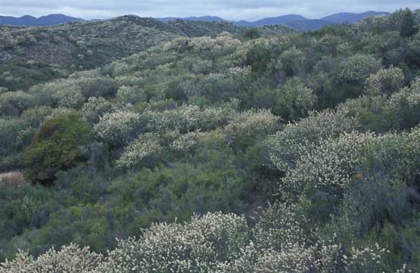
chaparral
small trees and bushes adapted to a Mediterranean climate

Slide 11
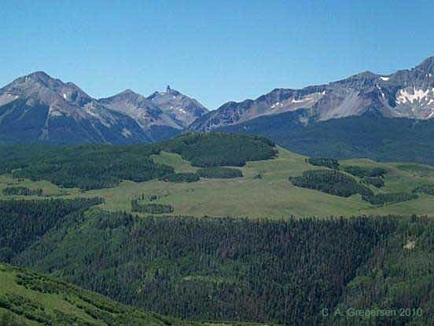
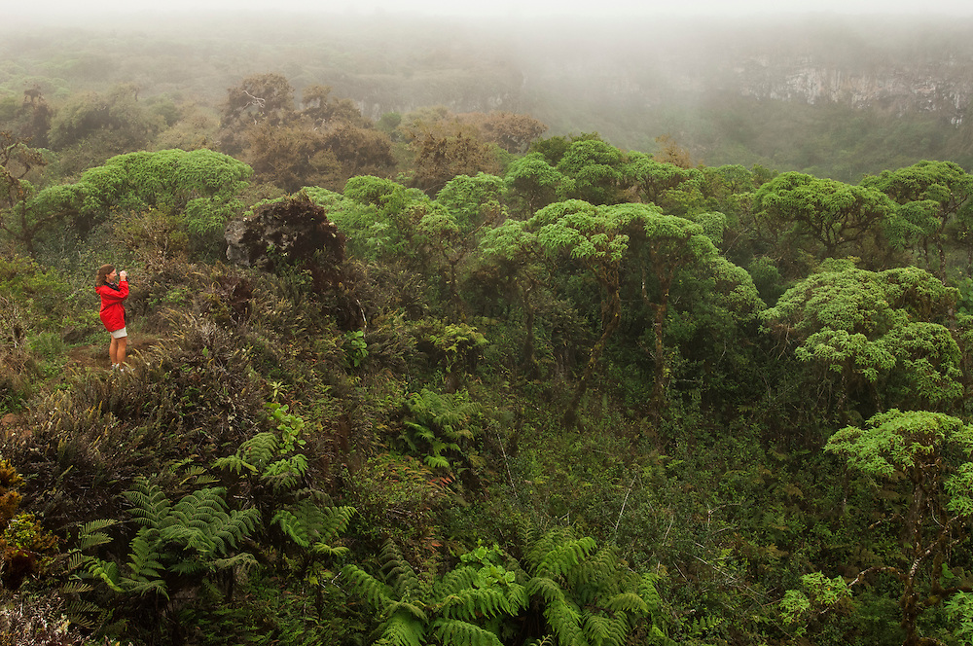
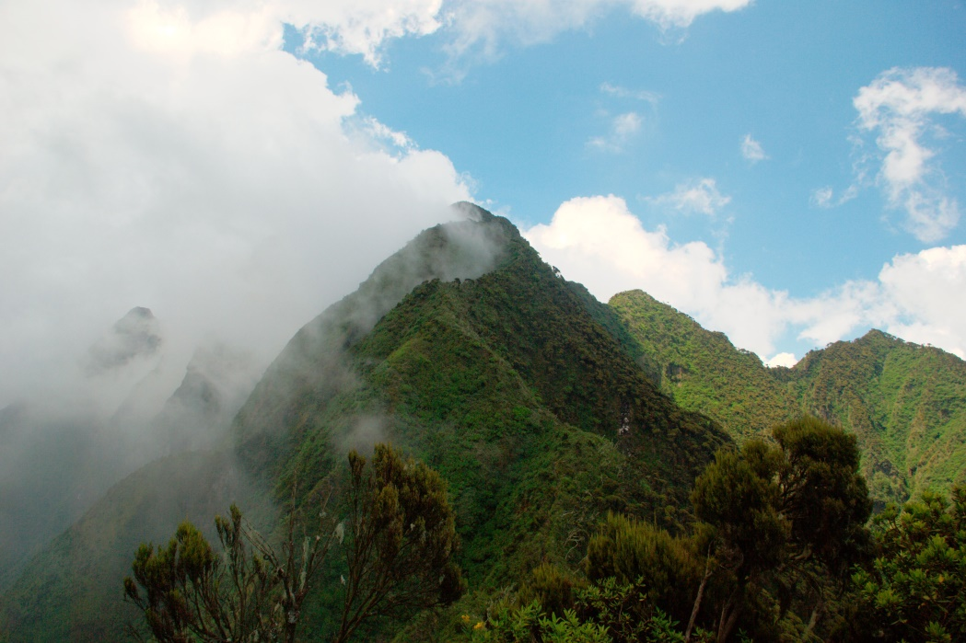
Highlands

Slide 12
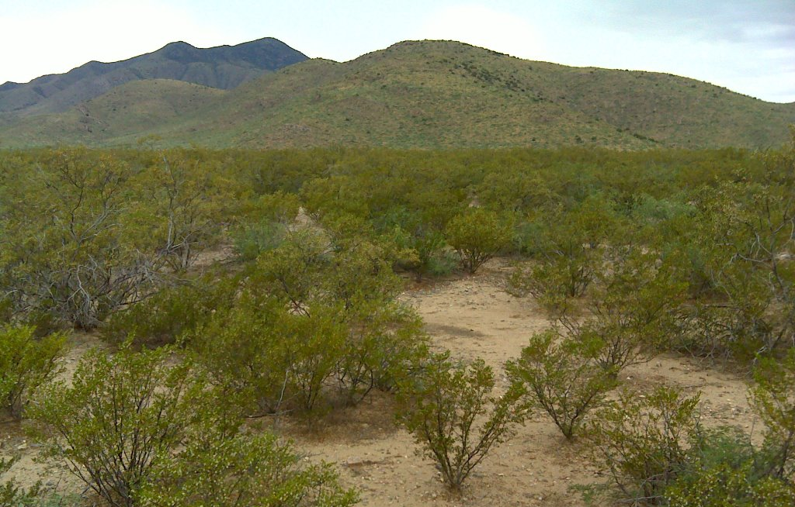
Desert scrub
small trees, bushes, and other plants adapted to a dry climate

Slide 13
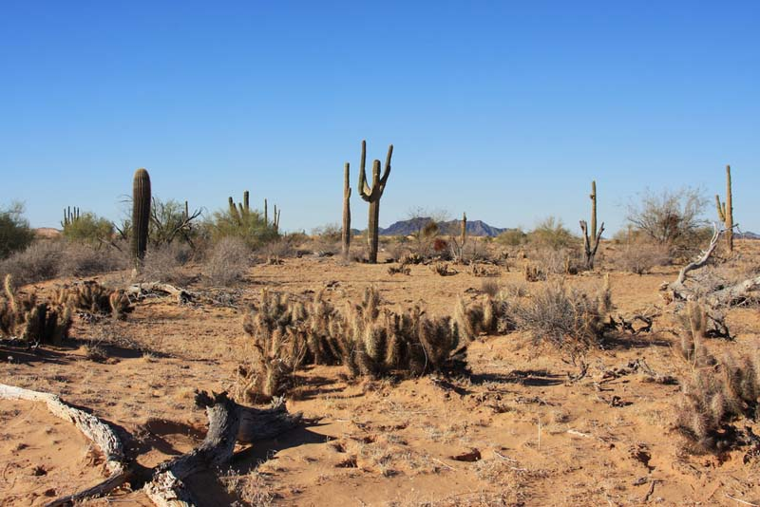
desert
arid region with few plants

