Slide 1
Population Density
In Michigan and beyond

Slide 2
Warren Michigan
As of the census of 2010, there were 134,056 people,53,442 households, and 34,185 families residing in the city. The population density was 3,899.2 inhabitants per square mile (1,505.5/km²)

Slide 3
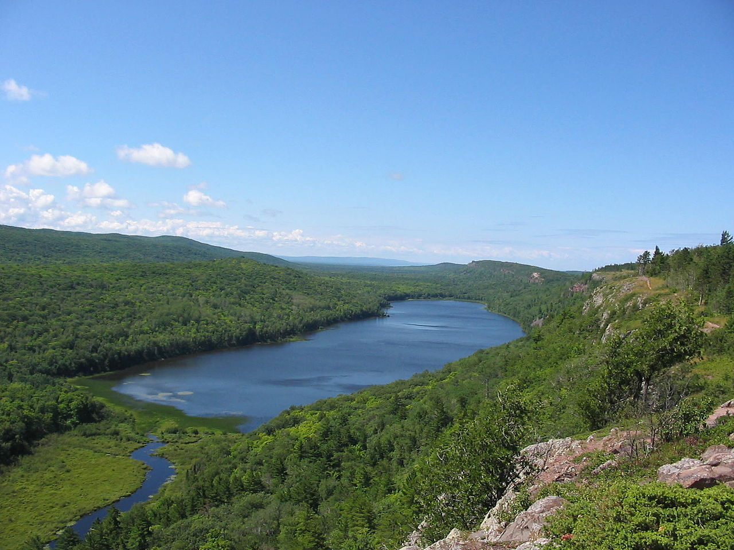
Upper peninsula
Highest point
- location | Mount Arvon
- elevation | 1,979 ft (603 m)
Area | 16,377 sq mi (42,416 km²)
Population | 311,361 (2010)
Density | 19/sq mi (7/km²)

Slide 4
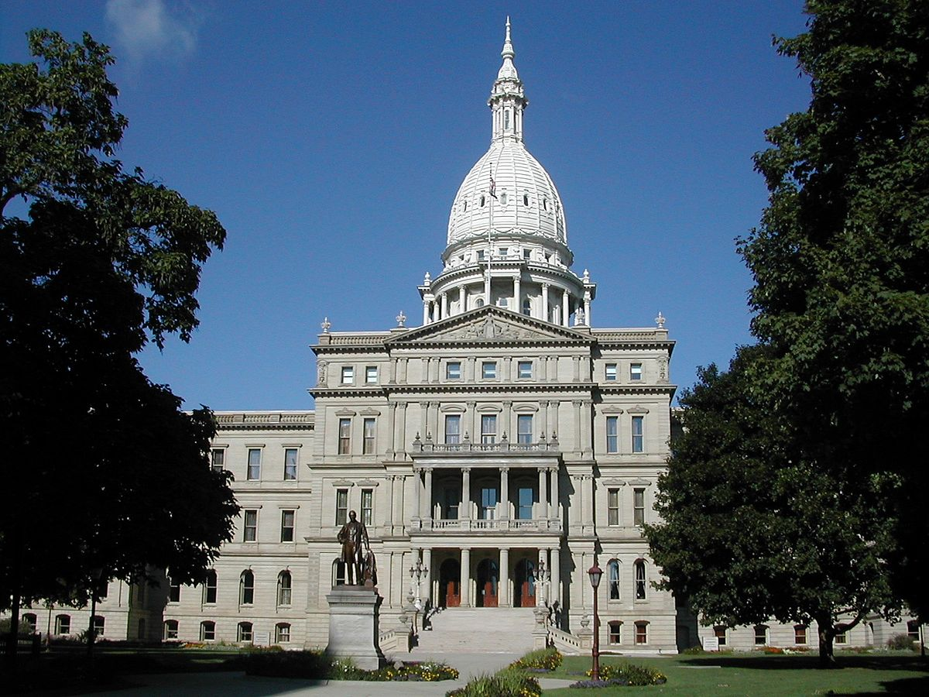
Lansing Michigan
As of the census of 2000, there were 119,128 people, 49,505 households, and 28,366 families residing in the city. The population density was 3,399.0 per square mile (1,312.3/km²).

Slide 5
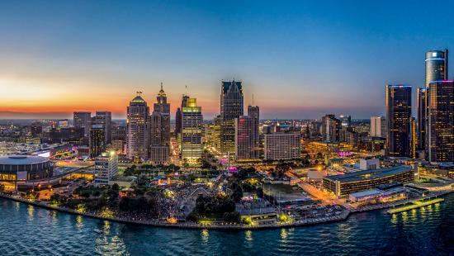
Detroit Michigan
The maps take into account the 139 square miles of land in the city, with a population of 677,116. This creates a population density of 4,878 persons per square mile.

Slide 6
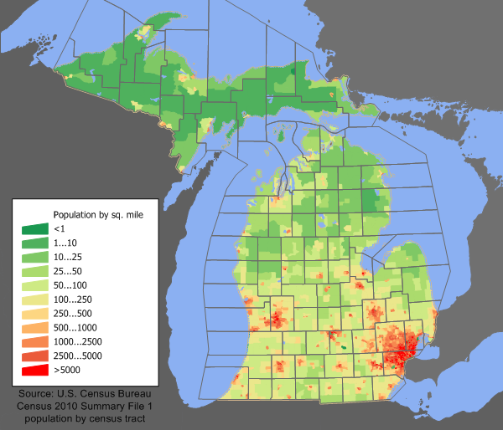
Michigan Population density

Slide 7
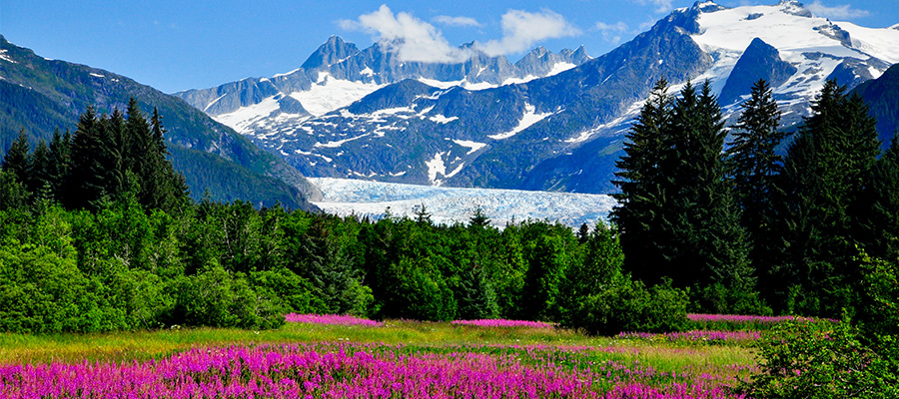
Alaska
In 2010, Alaska ranked as the 47th state by population. Alaska is the least densely populated state, and one of the most sparsely populated areas in the world, at 1.2 inhabitants per square mile (0.46/km²)

Slide 8
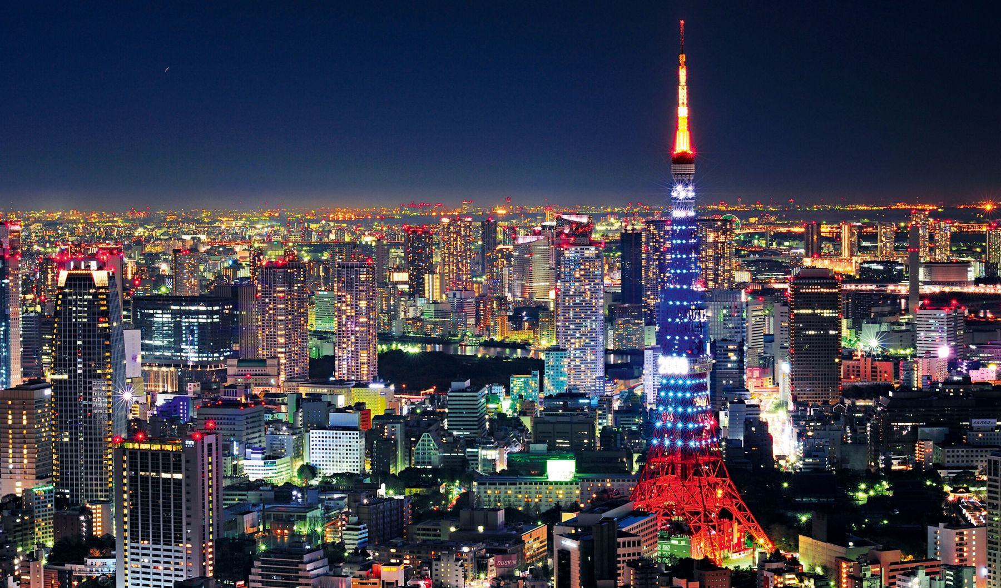
Tokyo japan
At 2,191 square kilometers, the area of Tokyo is 0.6% of the total area of Japan. With a population density of 9,852 persons per square mile, Tokyo is the most densely populated prefecture in Japan.

Slide 9
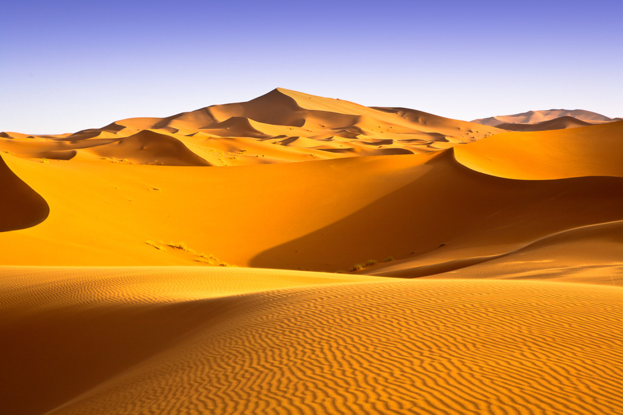
Sahara desert
The Sahara Desert covers over 3.5 million square miles and has only 2.5 million inhabitants, with a population density of less than 1 person per square mile.

Slide 10
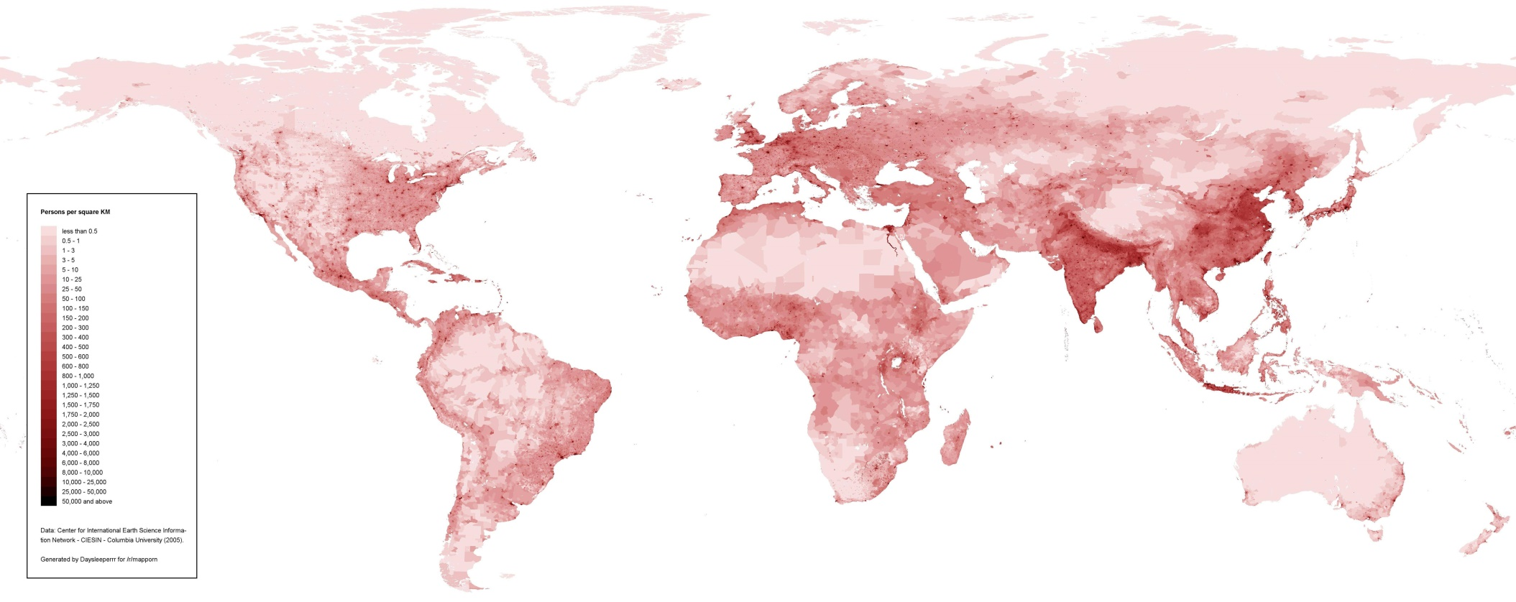
World Population Density
The capital and largest city of Bangladesh is Dhaka, which has a population of 14.4 million and a density of 19,447 people per square mile

Slide 11
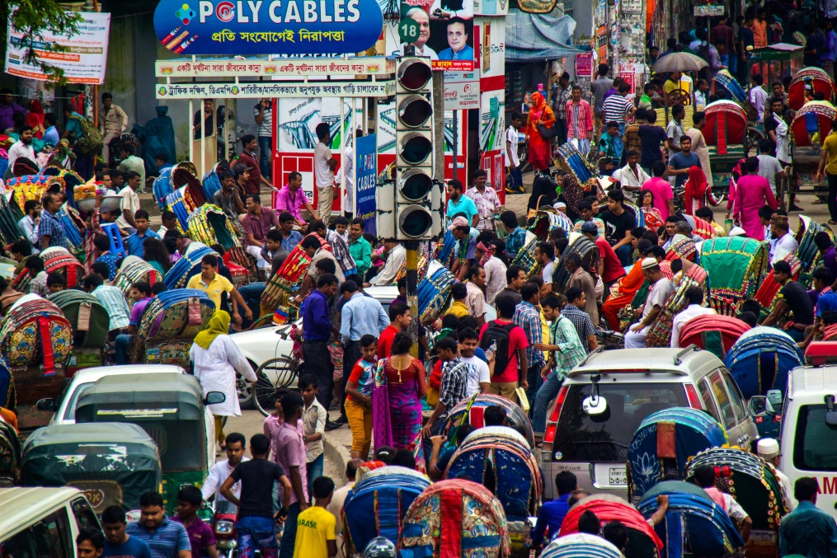
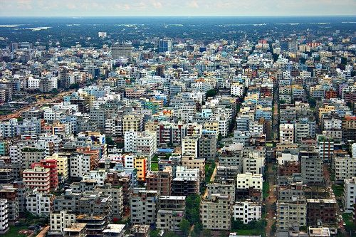
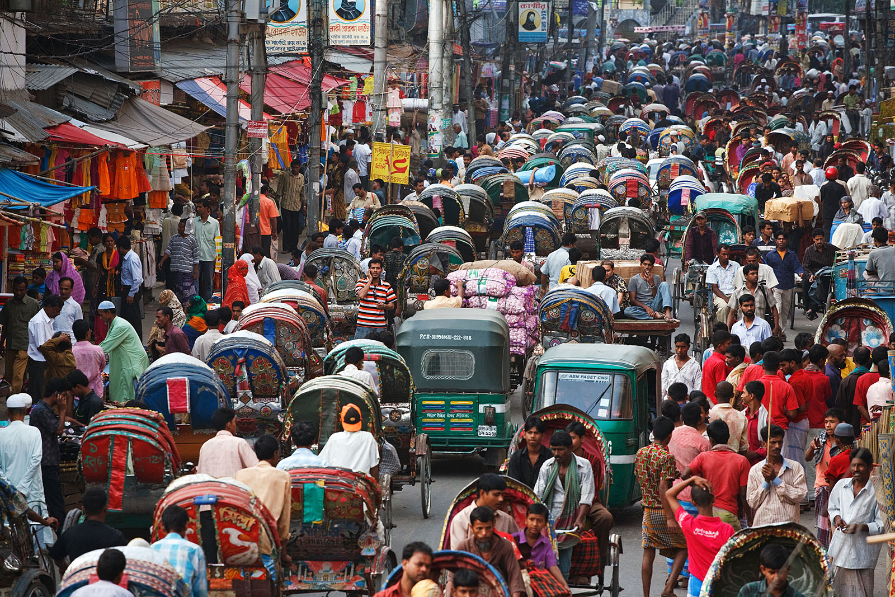
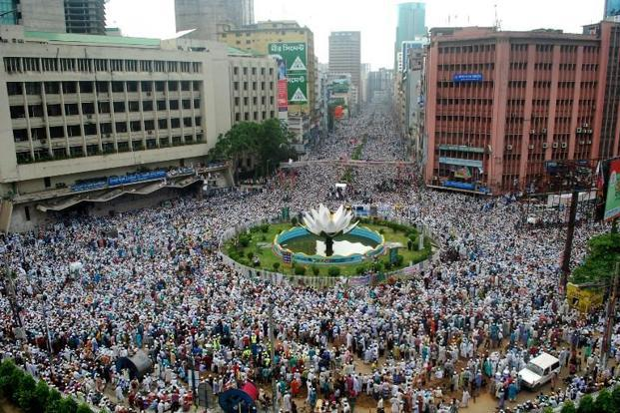
Dhaka, Bangladesh

